Slide 1

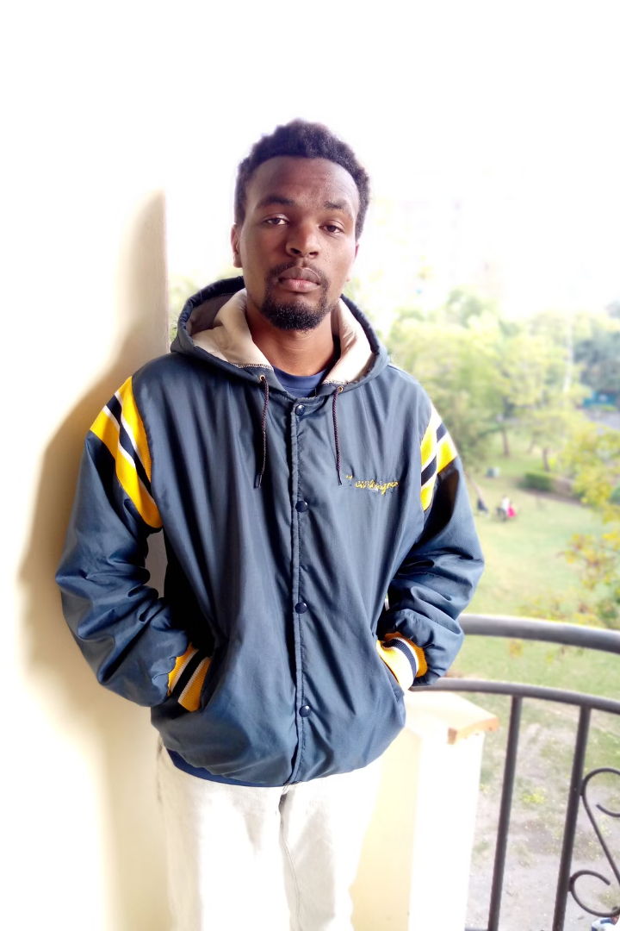
My Autobiography: John Mutua
I'm John Mutua, and I'm thrilled to share my life story with you. It's a journey filled with ups and downs, lessons learned, and unforgettable moments. From growing up in the vibrant town of Embu, Kenya, to pursuing my dreams at Dedan Kimathi University, this autobiography will take you through the tapestry of my experiences, challenges, and triumphs. Join me as I navigate the winding path of life, guided by the values instilled by my loving family and the opportunities that have shaped me into the person I am today.

Slide 2
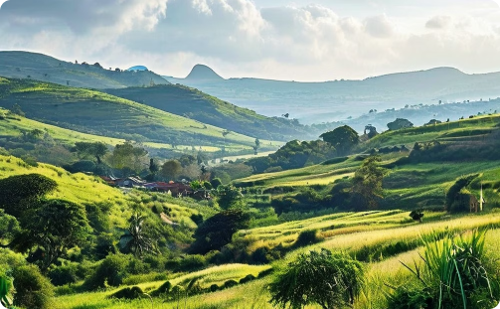
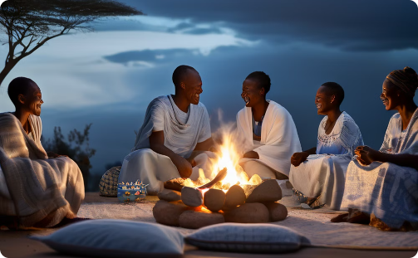
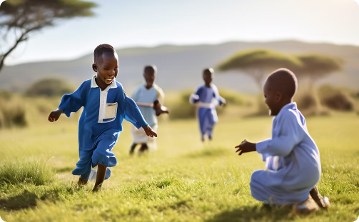
Growing Up in Embu
Vibrant Landscapes
Family Traditions
Childhood Adventures
Growing up in Embu, I was surrounded by the breathtaking beauty of Kenya's landscapes. From the verdant fields to the bustling markets, the town was a vibrant tapestry of culture and community that shaped my childhood experiences.
Our home was always filled with the warmth of family. Evenings were spent gathered around the fire, sharing stories and creating cherished memories that have stayed with me to this day.
As a child, I relished the simple joys of exploring nature, playing with my siblings, and immersing myself in the rich cultural traditions of our community. These experiences instilled in me a deep appreciation for the beauty of the world around me.

Slide 3
Rite of Passage: Circumcision
Healing and Reflection
Preparation
After the circumcision, I was taken back to the isolation site to heal and continue my education in the ways of manhood. This period was a time of reflection and growth, as I prepared to take on the responsibilities of being a responsible member of my community.
As a Kamba man, I vividly remember the preparation for my circumcision ceremony. It was a week-long period of isolation and instruction, where I learned the ways of my community and the responsibilities of manhood.
1
2
3
The Ceremony
The day of the circumcision was marked by singing, dancing, and the presence of my parents and relatives. The ceremony itself was a painful but significant rite of passage, as I was taught to be brave and endure the pain with dignity.

Slide 4
Navigating the Challenges of School Fees
Financial Hurdles
Perseverance and Determination
As I finished high school and prepared to join university, I faced the daunting challenge of affording the exorbitant tuition fees. With my family's limited resources, I was unable to secure the necessary funds to enroll, leaving me feeling hopeless and uncertain about my future.
Determined to pursue my dream of higher education, I took a gap year and took on various odd jobs, such as gardening, babysitting, and house cleaning, to save up the required fees. It was a challenging time, but I refused to give up, driven by my passion for learning and a desire to create a better future for myself.
Overcoming the Odds
After a year of hard work and perseverance, I finally managed to raise the funds needed to join Dedan Kimathi University of Technology. This experience taught me the value of determination, resilience, and the power of pursuing one's dreams, no matter the obstacles.

Slide 5
Embracing University Life
Academic Pursuits
Extracurricular Involvement
Balancing Responsibilities
At Dedan Kimathi University of Technology, I am pursuing a Bachelor of Science degree in BBIT, immersing myself in the world of numbers and problem-solving. Alongside my main course, I'm also pursuing a minor degree in communication skills, recognizing the importance of effective communication in any field.
Beyond the classroom, I've taken on the exciting challenge of training to become a referee for the Football Kenya Federation (FKF). This opportunity has taught me valuable lessons in leadership, decision-making, and teamwork, skills that are essential both on and off the field.
Balancing my academic studies with my referee training requires careful time management and dedication, but I'm committed to excelling in both areas. Each experience contributes to my personal and professional development, shaping me into a well-rounded individual.

Slide 6
Passion for Charitable Causes
1
Community Service Program
2
Red Cross Club
At Dedan Kimathi University, I have been actively involved in the Community Service Program, which provides opportunities for students to participate in various community projects, including health and sanitation, environmental conservation, and education initiatives.
Through the university's Red Cross Club, I have had the chance to engage in charitable activities such as blood donation drives, disaster response and management, and public health campaigns, allowing me to make a positive impact on the lives of others.
3
Student Government Initiatives
The student government at Dedan Kimathi University also organizes various charity events throughout the academic year, such as fundraising activities to support initiatives like building water wells, providing food and shelter to the homeless, and donating educational materials to underprivileged children.

Slide 7



Rediscovering My Passions
Football
Swimming
Hiking
Rediscovering my passion for football has been a transformative experience, enhancing both my physical and mental well-being. Playing the sport has provided me with a sense of relaxation, reduced stress, and improved my overall fitness.
Reconnecting with my love for swimming has also been a life-changing experience. The activity has not only improved my physical health but has also positively impacted my mental well-being, allowing me to unwind and de-stress.
The proximity of Dedan Kimathi University to the stunning Aberdare Ranges and Mt. Kenya has provided me with ample opportunities to explore the great outdoors through hiking. These adventures have allowed me to connect with nature and recharge my batteries.

Slide 8




Passion for Manchester City
History and Tradition
Rivalries
Community
As a Manchester City fan, I feel a strong connection to the club's rich history and legendary players, which adds to the excitement and pride of supporting the team.
The intense rivalries between Manchester City and other top clubs, such as Manchester United and Liverpool, contribute to the thrill and intensity of the matches, making the experience of being a fan even more exhilarating.
Supporting Manchester City has allowed me to connect with other football fans, building a sense of community and camaraderie that enhances the overall experience of being a fan.

Slide 9
Embracing Challenges and Opportunities
Academic Pursuits
Studying Mathematics and Modeling Processing at Dedan Kimathi University of Technology is both stimulating and demanding, constantly challenging me to think critically, analyze complex problems, and develop innovative solutions.
Communication Skills
Pursuing a minor degree in communication skills has provided me with invaluable tools for effective communication, whether it's presenting research findings, collaborating with peers, or engaging in discussions with faculty members.
Refereeing
Officiating football matches as an FKF referee requires a unique blend of focus, composure, and decisiveness, which I approach with a sense of professionalism and integrity, striving to ensure fair play and uphold the spirit of the sport.

Slide 10

Conclusion: Embracing the Journey
Overcoming Challenges
Pursuing Passions
Embracing the Future
Throughout my journey at Dedan Kimathi University, I have faced various challenges, from managing my time effectively to navigating academic pressures. However, I have learned to be resilient, adaptable, and to seek support when needed, emerging stronger and more capable with each obstacle I overcome.
Whether it's my love for agriculture, my ambition to become a top investor, or my dedication to making a positive impact through charitable work, I remain committed to exploring and pursuing my passions. These endeavors not only bring me fulfillment but also allow me to contribute to the betterment of society.
As I look towards the future, I do so with a sense of optimism and excitement, eager to embrace the adventures that lie ahead. I am confident in my ability to navigate the twists and turns of life, guided by the lessons and experiences that have shaped me into the person I am today.

